Slide 1
TESTING

Slide 2
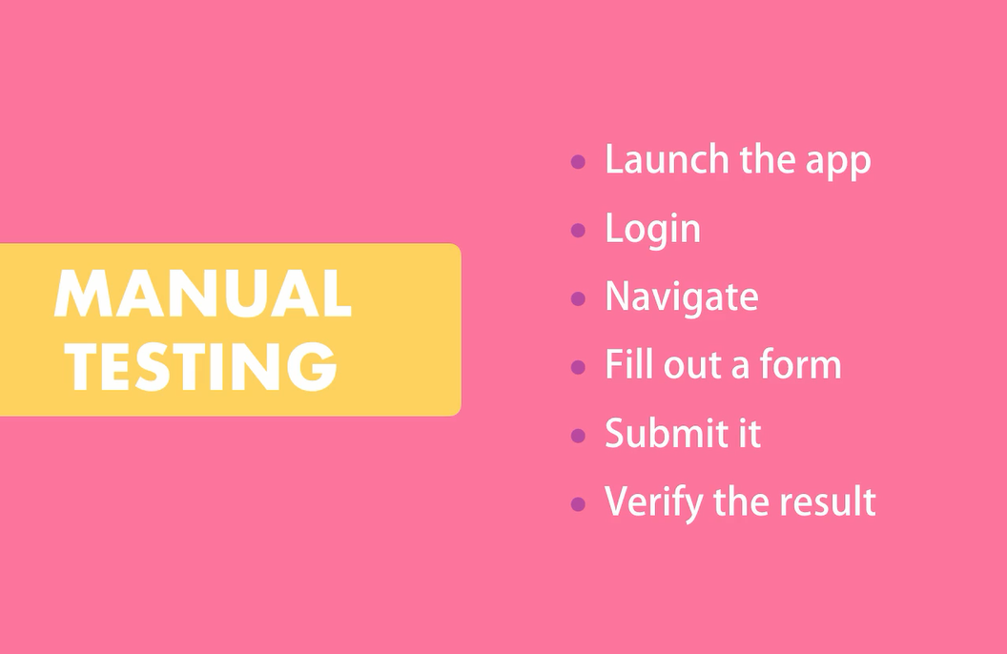
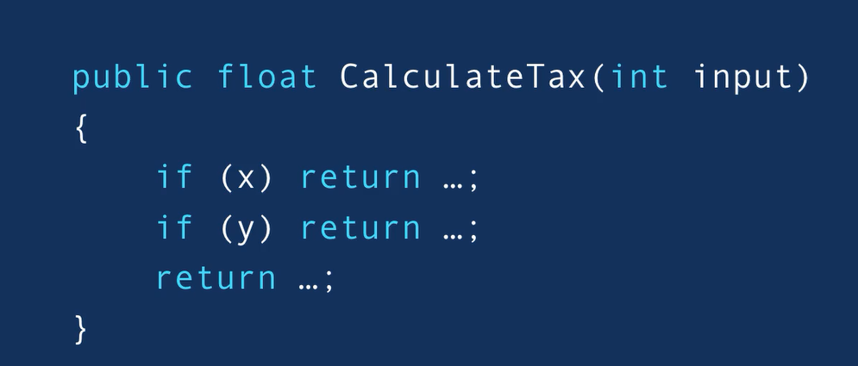
What is automated Testing?
The Practice of writing code to test our code, and then run those tests in an automated fashion.
Assuming you have a function like this and you want to test it manually :

Slide 3
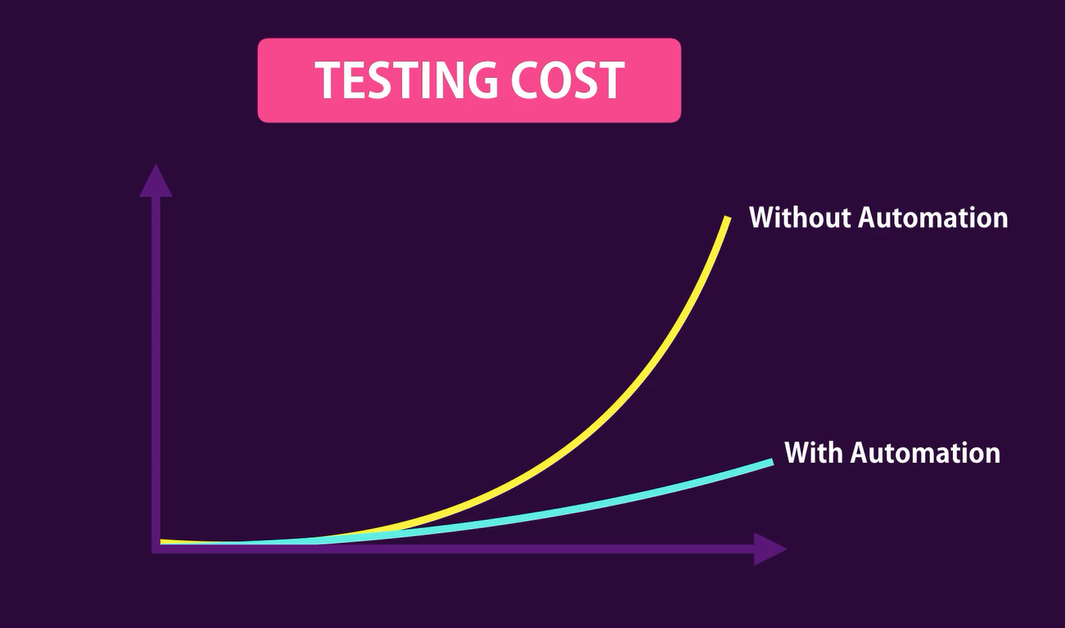

Slide 4
Benefits of automated Testing
Test your code frequently , in less time.
Catch bugs before deploying the application
Deploy your code
Help refractor your code with confidence – make it cleaner and maintainable
Focus more on quality of method you are writing

Slide 5
Types of Tests
Unit Testing
Test a unit of an application without its external dependencies
Cheap to write and execute fast
But sing you just testing a single unit not the whole application we are not 100% confident about unit testing so we need:
Integration Testing
Test the application with its external dependencies.
Take longer to execute , but gives you more confidence
End-To-End Testing
Drives an Application through its UI
Gives you great confidence
They are slow- They require launching the application They are brittle – a change can lead to the failure.

Slide 6
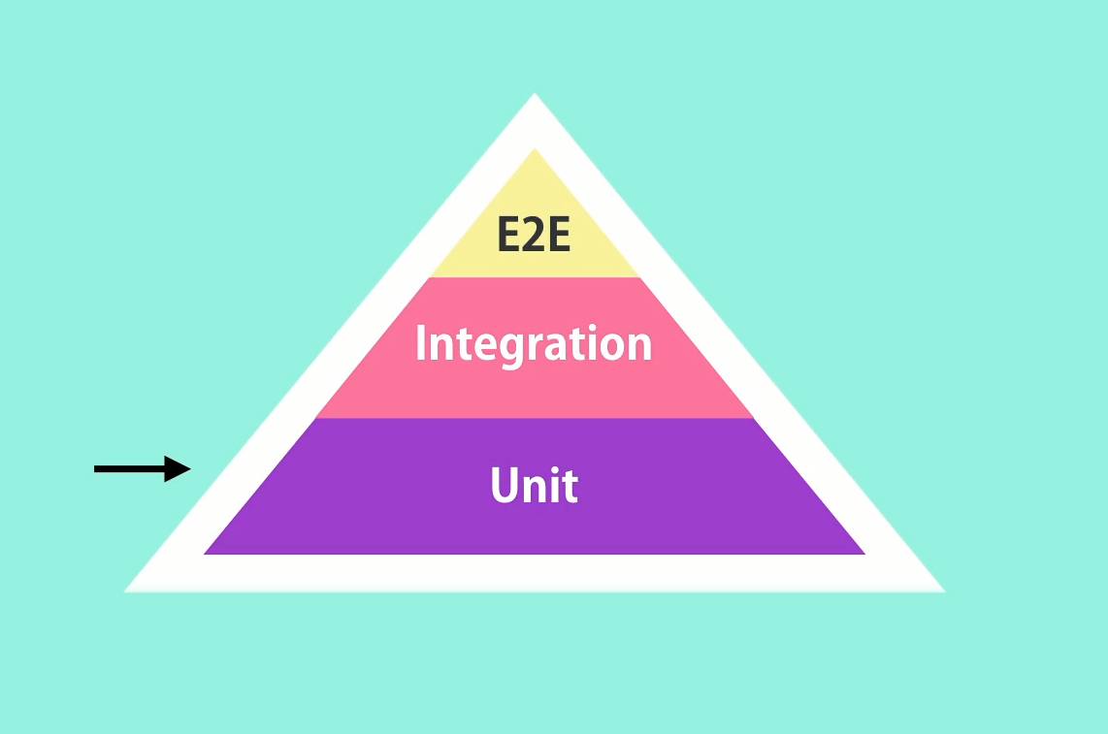
Testing Pyramid
In an application write more unit tests, but since writing unit test doesn’t give you the confidence that your application is working well write some integration tests. Also write end-to end Testing to test application flows .
The actual ration between unit, integration and end-to-end depends on your project
Favour unit tests to e2e tests.
Cover unit test gaps with integration tests
Use End-to-2nd tests sparingly

Slide 7
Testing Framework
NUnit- Earliest
MSTest – Microsoft testing framework
Xunit – Gained popularity recently
All this frameworks gives you a Library to help you write your test and a Test runner to help you run your test and get reports on passing and failing tests
But focus on Testing not which tooling to u se

Slide 8
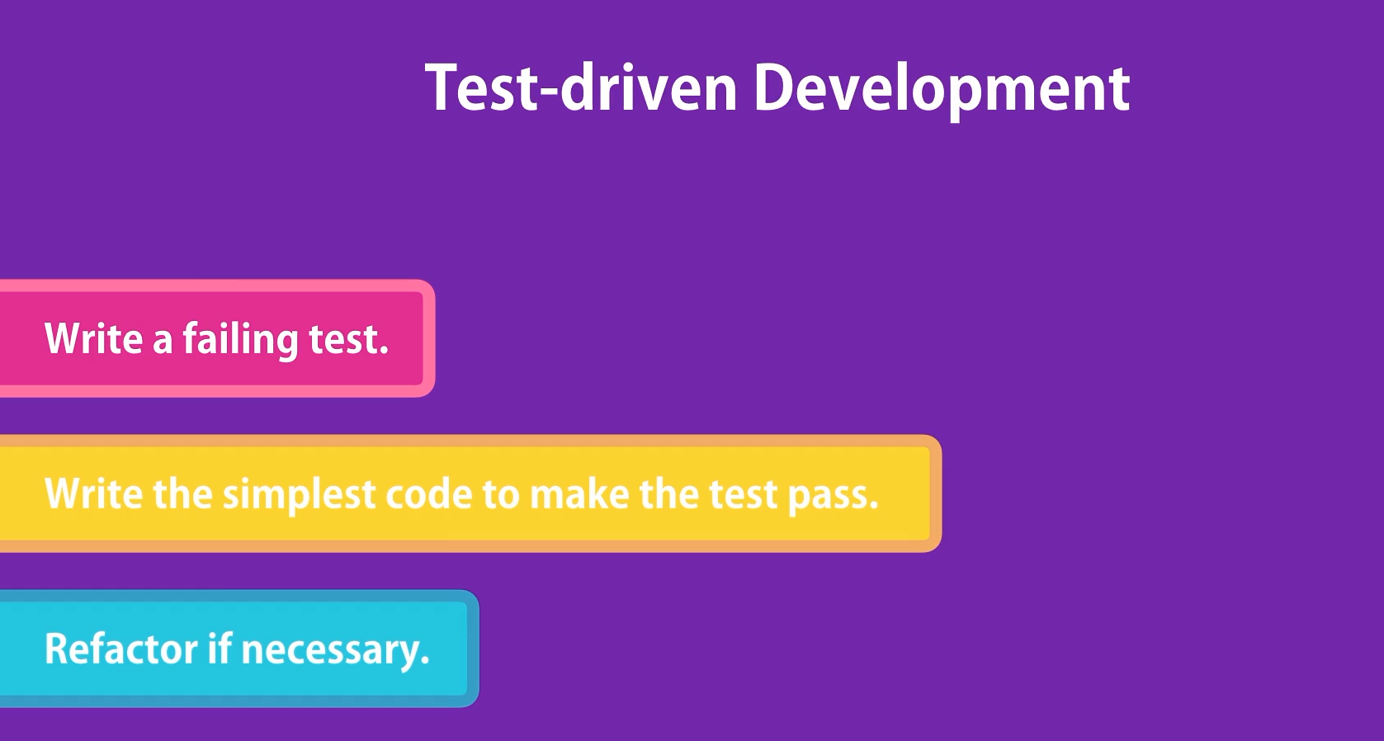
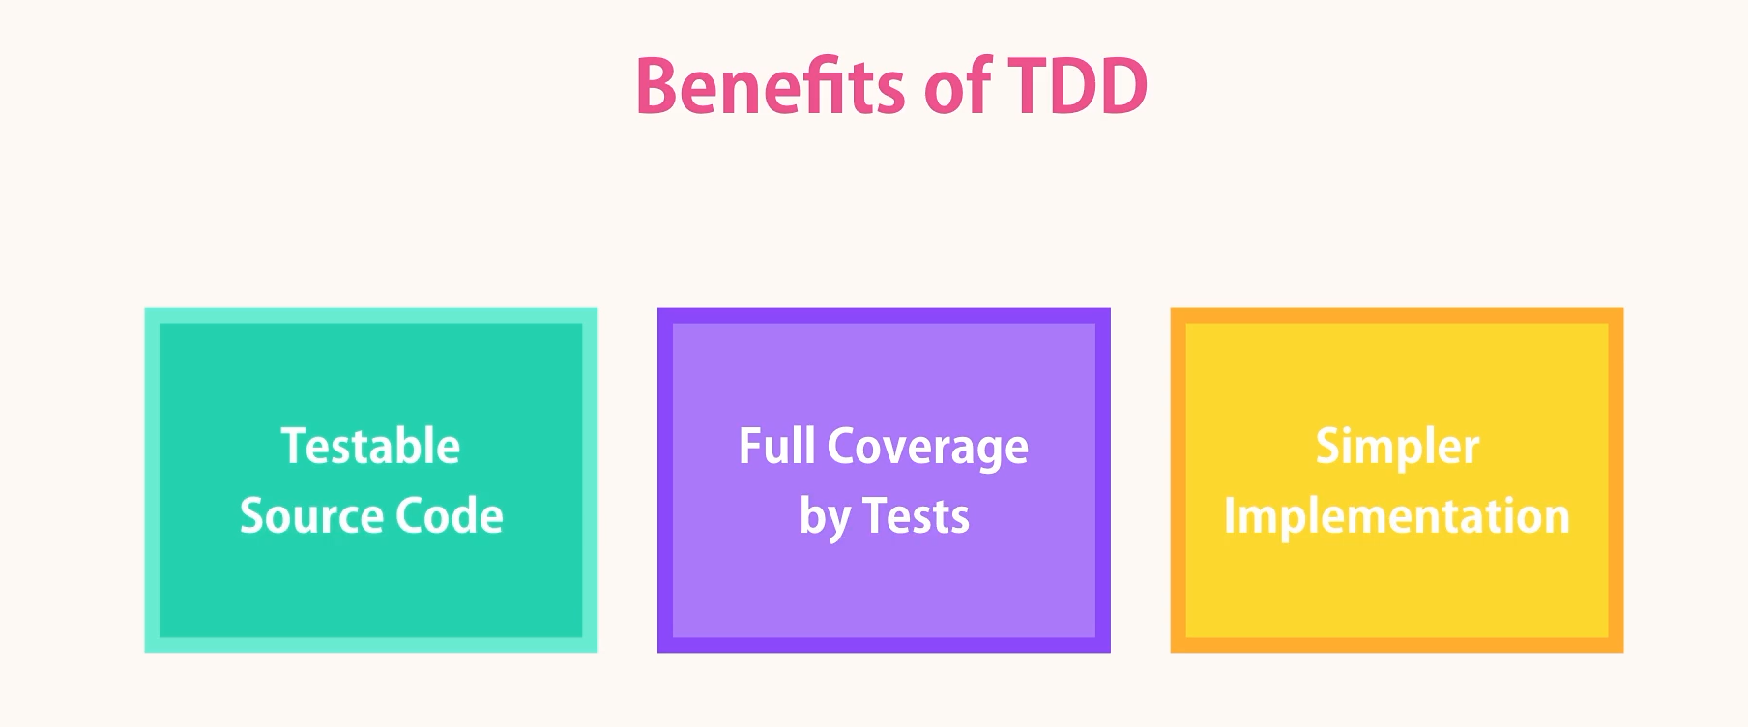
Test-Driven Development
This is a common Term , TDD is an approach that involves writing your tests before writing the production code .

